Slide 1



Slide 2
ENERGY EFFICIENCY

Slide 3
INTRODUCTION
The energy efficiency of a building is the extent to which the energy consumption per square meter of floor area of the building measures up to established energy consumption benchmarks for that particular type of building under defined climatic conditions. Building energy consumption benchmarks are representative values for common building types against which a building’s actual performance can be compared.

Slide 4
Efficient energy uses
Efficient energy use, sometimes simply called energy efficiency, is the goal to reduce the amount of energy required to provide products and services.
For example, insulating a home allows a building to use less heating and cooling energy to achieve and maintain a comfortable temperature. Installing LED lighting, fluorescent lighting, or natural skylight windows reduces the amount of energy required to attain the same level of illumination compared to using traditional incandescent light bulbs. Improvements in energy efficiency are generally achieved by adopting a more efficient technology or production process or by application of commonly accepted methods to reduce energy losses.

Slide 5

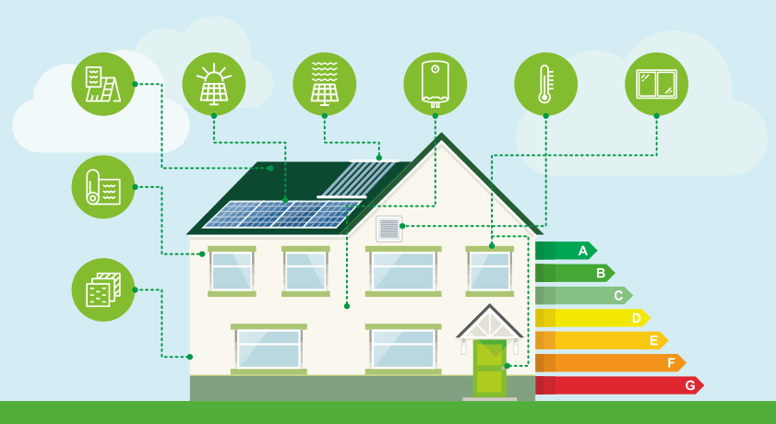
Problem Statement
To determine the output variables of HL & CL of residential buildings.

Slide 6
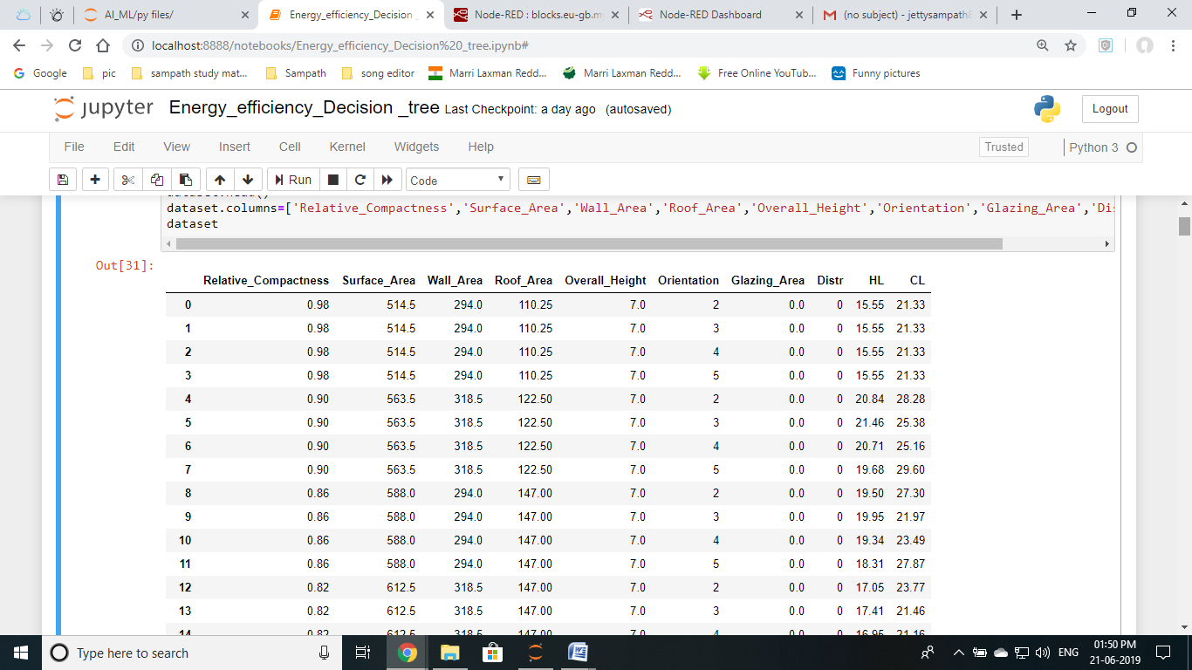
Data Set
.
.
.
768

Slide 7
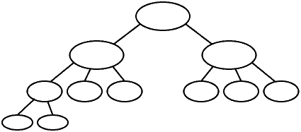
Algorithm
Decision Tree
root node
Decision node
Decision node
Leaf node

Slide 8
Supervised learning process
Dataset
Learning Algorithm
Training Data
Train Model
Splitting the data
Data cleaning
Testing Data
Score Model
Evaluate Model
Notes:
8

Slide 9
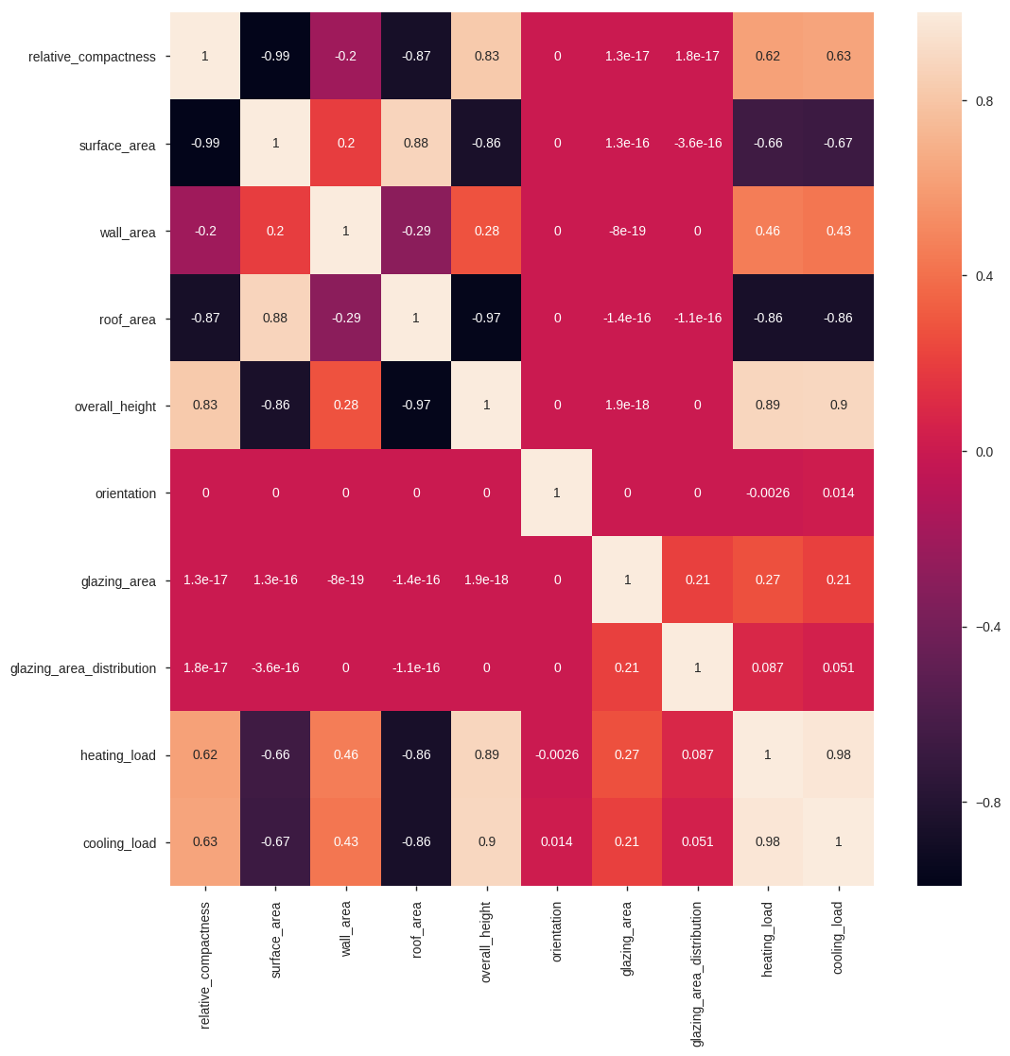
Heat Map

Slide 10
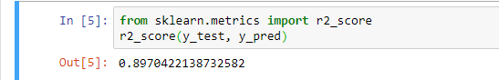
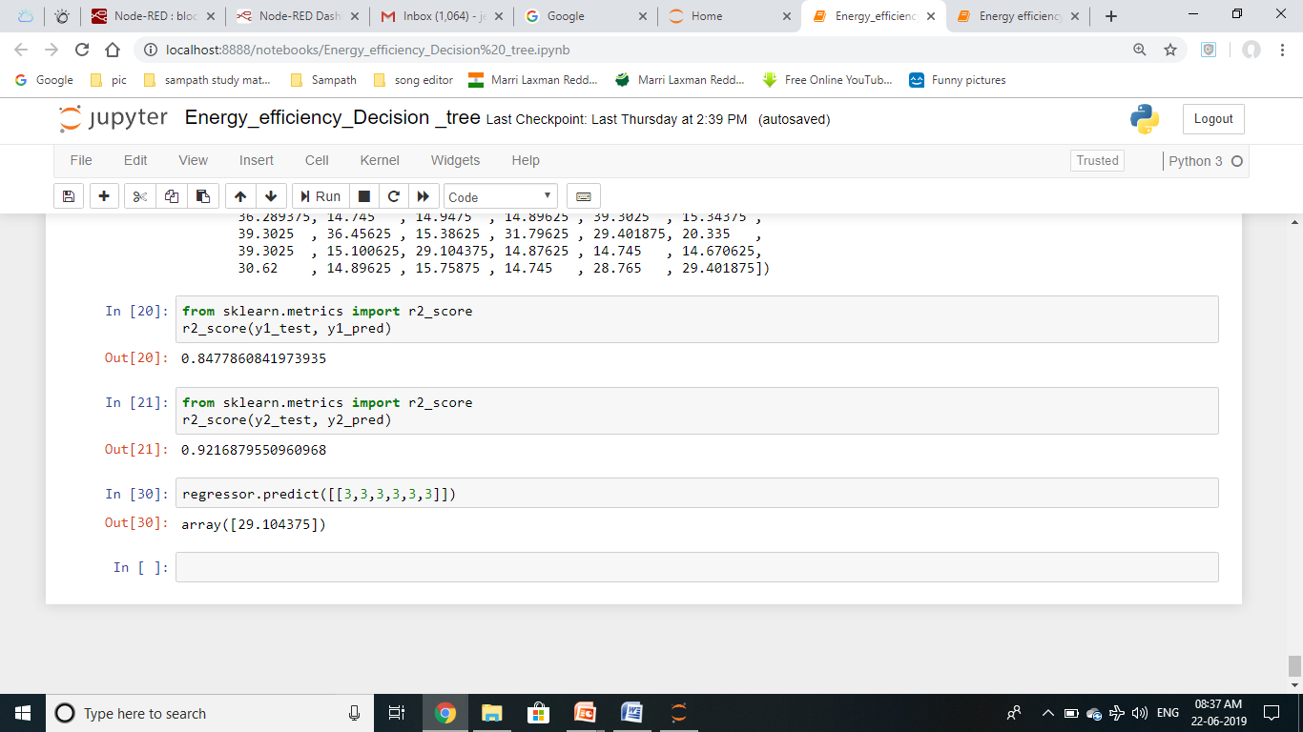
Different Models
Linear Regression

Slide 11
Accuracy
Decision Tree

Slide 12
Conclusion
The model we perform is to predict the Heating Load and Cooling Load with R2 score >= 97%. The predict the Heating Load and Cooling Load values with the optimum R2 score of 84.7% and 92.1% respectively.

Slide 13

P.VARSHINI
P.AKANKSHA
J.SAMPATH
HIMABINDU
TEAM - 9

